Slide 1
More than teaching English
25th IATEFL POLAND CONFERENCE
Szczecin 2016

Slide 2
CHALLENGES
Is it in the curriculum?
Isn’t it only for more advanced students?
How can it be fun for my students?
Where can I find some materials for teaching about tolerance?
Where is the language practice?
Am I alone?
How to make it more than just teaching English?

Slide 3
Is it in the curriculum?
Celem kształcenia ogólnego w szkole jest: kształtowanie u uczniów postaw warunkujących sprawne i odpowiedzialne funkcjonowanie we współczesnym świecie.
W procesie kształcenia ogólnego szkoła (podstawowa/gimnazjum) kształtuje u uczniów postawy sprzyjające ich dalszemu rozwojowi indywidualnemu i społecznemu, takie jak: uczciwość, wiary godność, odpowiedzialność, wytrwałość, poczucie własnej wartości, szacunek dla innych ludzi, ciekawość poznawcza, kreatywność, przedsiębiorczość, kultura osobista, gotowość do uczestnictwa w kulturze, podejmowania inicjatyw oraz do pracy zespołowej. W rozwoju społecznym bardzo ważne jest kształtowanie postawy obywatelskiej, postawy poszanowania tradycji i kultury własnego narodu, a tak że postawy poszanowania dla innych kultur i tradycji. Szkoła podejmuje odpowiednie kroki w celu zapobiegania wszelkiej dyskryminacji.

Slide 4
Curriculum highlights
fairness
honesty
responsibility
consistence
self-esteem
civic responsibility
creativity
curiosity about the world
respect for traditions and customs of other cultures

Slide 5
Isn’t it only for more advanced students?
ID
https://www.google.pl/search?q=ID+card&espv=2&biw=1366&bih=677&tbm=isch&tbo=u&source=univ&sa=X&ved=0ahUKEwiV4u6g28XOAhVTOMAKHXnCAi0QsAQIGg#tbm=isch&q=ID+funny+&imgrc=uOI5oA9Ncqr9pM%3A

Slide 6
My roles in life
Ask your students to outline their palms and write one role they play in their life in each finger, eg. a brother, a sister, a friend, a musician, a football player, a student, etc. They choose the most important one, then they talk with other students and explain their choice.

Slide 7
The groups I belong to
Ask your students to think about five groups they belong to, eg. the group of people who wear glasses, the group of people who learn at school, the group of people who are only children, etc. When they are ready the teacher reads out different names of groups, if a student belongs to it, they have to stand up for a moment. After a while ask students to walk around the classroom to find what other groups were mentioned by their classmates. To finish ask students how they felt when they were the only ones to stand up or when they stood up in a group, ask them what they have learnt about other students.

Slide 8
How can it be fun for my students?
Serious but fun –
online games

Slide 9
Against all odds http://www.playagainstallodds.ca/

Slide 10
3rd world farmer http://3rdworldfarmer.com/

Slide 11
Spent http://playspent.org/

Slide 12
Free rice http://freerice.com/#/english-vocabulary/1402

Slide 13
Where is the language practice?
https://static.independent.co.uk/s3fs-public/indy100/e1t_MupEpl/22521-1qchzq8.jpg

Slide 14
Gallery tour
Change your mind changing your perception
https://www.google.pl/search?q=change+your+mind&espv=2&biw=1366&bih=677&source=lnms&tbm=
isch&sa=X&ved=0ahUKEwjArfKbyMXOAhUlJJoKHUICALkQ_AUIBigB#imgrc=UI7iDRFjV3_1nM%3A

Slide 15
Ask your students to find different explanations for the following sentences.
John never says
good morning to teachers.

Slide 16
She always wears a hat with a wide brim.
He often avoids me in the corridor.
One of my students is very talkative.
They don’t read any books.

Slide 17
Where can I find some materials for teaching about tolerance?
27 January International Holocaust Remembrance Day
21 March International Day for the Elimination of Racial Discrimination
8 April World Roma Day
4 June International Day of Innocent Children Victims of Aggression
20 June World Refugee Day
1 October International Day of Older Persons
2 October International Day of Non-Violence
16 November International Day for Tolerance
10 December Human Rights Day

Slide 18
https://sustainabledevelopment.un.org/sdgs

Slide 19
Authentic materials - videos
How much can 4 minute change?
A lesson based on a video called „Look beyond borders – 4 minute experiment” by Amnesty International
https://www.youtube.com/watch?v=f7XhrXUoD6U

Slide 20
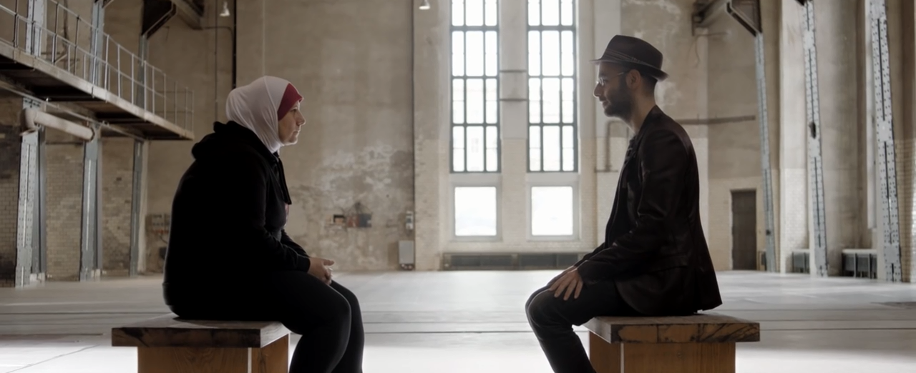

Slide 21
The photos are screenshots from the Amnesty International film „Look beyond borders”.

Slide 22
How much can 4 minutes change?
1. Ask students: What can you do for four minutes? Give them some time to think and then gather ideas. Tell them that some time ago a psychologist Arthur Aron did some research thanks to which he concluded that four minutes of looking each other in the eyes can make people closer to each other. Tell students that they are going to watch a film based on this experiment. Their task will be to name emotions of the people and their actions. 2. Play the film to 0:30 (in this fragment people have closed eyes), stop and ask them to name emotions of the participants of the experiment. 3. Play the film to 1:00 (people open eyes), stop and ask them to name emotions and reactions of the participants of the experiment. 4. Play the rest of the video. Ask students to write down all the reactions and actions of the people appearing in the film. Students present the activities. 5. After students have watched the film ask them to choose one pair from the film and prepare a short imaginary conversation between them which might have happened just after the end of the experiment. Some pairs present their dialogues.

Slide 23
Am I alone?
INSPIRATIONS
SIG IATEFL PL Global Issues https://gisigpl.wordpress.com/
SIG IATEFL Global Issues http://gisig.iatefl.org/
http://www.tesol.org/ → Interest Sections
http://film-english.com/
Szkoła Tolerancji (Centrum Edukacji Obywatelskiej)
http://en-joyenglish.weebly.com/

Slide 24
How to make it more than just teaching English?
Be consistent
Use simple exercises
Decide whether to discuss hot topics on the spot or give students more time to think them over and be familiar with
Teaching about tolerance is an ongoing process
Give students time to express their emotions

Slide 26
You are welcome to contact us We love to be bothered
Katarzyna Łaziuk
kasia.laziuk@gmail.com
Katarzyna wiącek
kkatarzyna.wiacek@gmail.com

