Slide 1
Civil Rights Movement and Martin Luther King Jr

Slide 2
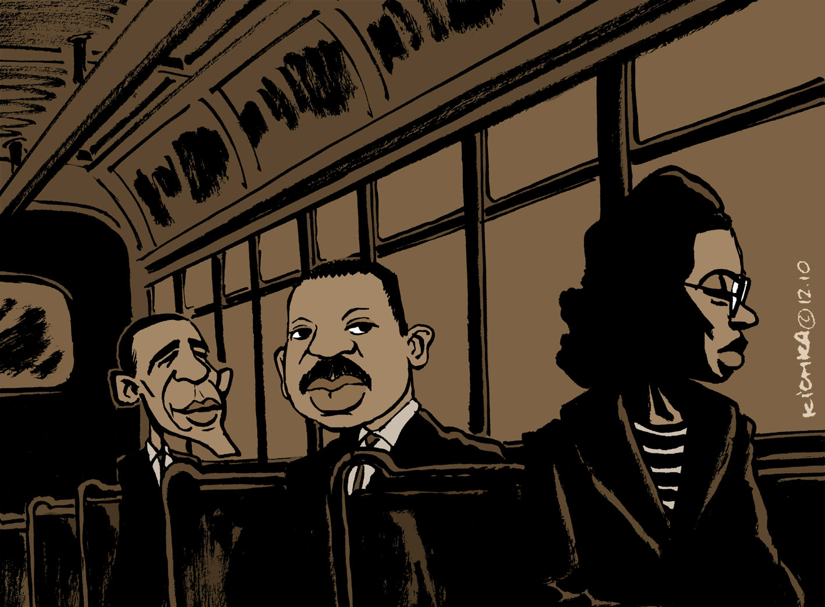

Slide 3
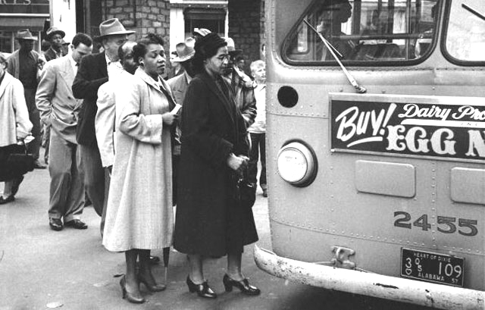

Slide 4
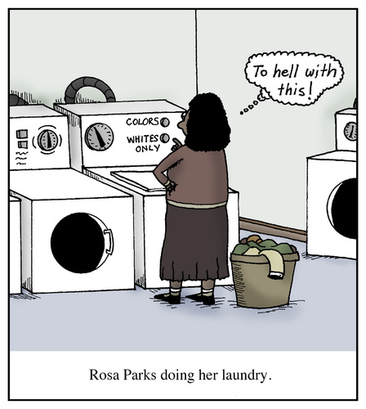

Slide 5
13th Amendment 1865
abolished slavery and involuntary servitude

Slide 6
Segregation
https://www.youtube.com/watch?v=c-7eNRB2_0Q

Slide 7
Rosa Parks and her influence
http://www.history.com/topics/black-history/montgomery-bus-boycott

Slide 8
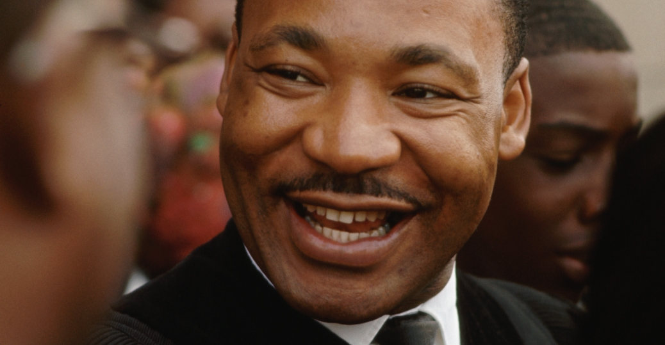

Slide 9
Martin Luther King and the March on Washington
http://www.history.com/topics/black-history/martin-luther-king-jr/videos/martin-luther-king-jr-leads-the-march-on-washington

Slide 10
Bibliography
http://www.history.com/topics/black-history/martin-luther-king-jr/pictures/martin-luther-king-jr/martin-luther-king-jr-greeting-parishioners
http://2.bp.blogspot.com/-r8nC_oPrwK4/TVxSwUwybdI/AAAAAAAAAWA/KoMYKV_YcUE/s1600/Montgomery+Bus+Boycott+Smithsonian+Institute+Photo+Don+Cravens+Courtesy+Time+Life+Pictures+Getty+Images.jpg
https://kichkaen.files.wordpress.com/2010/12/rosa-parks1955.jpg
https://www.toonpool.com/user/67706/files/rosa_parks_doing_her_laundry_1839325.jpg

